Slide 1
Statistical Quality Control(SQC)

Slide 2
QUALITY CONTROL
DEFINITION OF QUALITY:
The meaning of “Quality” is closely allied to cost and customer needs. “Quality” may simply be defined as fitness for purpose at lowest cost.
The component is said to possess good quality, if it works well in the equipment for which it is meant. Quality is thus defined as fitness for purpose.
Quality is the ‘totality of features and characteristics’ both for the products and services that can satisfy both the explicit and implicit needs of the customers.
“Quality” of any product is regarded as the degree to which it fulfills the requirements of the customer.
“Quality” means degree of perfection. Quality is not absolute but it can only be judged or realized by comparing with standards. It can be determined by some characteristics namely, design, size, material, chemical composition, mechanical functioning, workmanship, finish and other properties.

Slide 3
MEANING OF CONTROL
Control is a system for measuring and checking (inspecting) a phenomenon. It suggests when to inspect, how often to inspect and how much to inspect. In addition, it incorporates a feedback mechanism which explores the causes of poor quality and takes corrective action.
Control differs from ‘inspection’, as it ascertains quality characteristics of an item, compares the same with prescribed quality standards and separates defective items from non-defective ones. Inspection, however, does not involve any mechanism to take corrective action.

Slide 4
MEANING OF QUALITY CONTROL
Quality Control is a systematic control of various factors that affect the quality of the product. The various factors include material, tools, machines, type of labour, working conditions, measuring instruments, etc.
Quality Control can be defined as the entire collection of activities which ensures that the operation will produce the optimum Quality products at minimum cost.
As per A.Y. Feigorbaum Total Quality Control is: “An effective system for integrating the quality development, Quality maintenance and Quality improvement efforts of the various groups in an organization, so as to enable production and services at the most economical levels which allow full customer satisfaction”

Slide 5
FACTORS AFFECTING QUALITY
In addition to men, materials, machines and manufacturing conditions there are some other factors which affect the product quality. These are:
Market Research i.e. in depth into demands of purchaser.
Money i.e. capability to invest.
Management i.e. Management policies for quality level.
Production methods and product design.
Modern quality control begins with an evaluation of the customer’s requirements and has a part to play at every stage from goods manufactured right through sales to a customer, who remains satisfied.

Slide 6
OBJECTIVES OF QUALITY CONTROL
To decide about the standard of quality of a product that is easily acceptable to the customer and at the same time this standard should be economical to maintain.
To take different measures to improve the standard of quality of product.
To take various steps to solve any kind of deviations in the quality of the product during manufacturing.

Slide 7
ADVANTAGES OF QUALITY CONTROL
Quality of product is improved which in turn increases sales.
Scrap rejection and rework are minimized thus reducing wastage. So the cost of manufacturing reduces.
Good quality product improves reputation.
Inspection cost reduces to a great extent.
Uniformity in quality can be achieved.
Improvement in manufacturer and consumer relations.

Slide 8
STATISTICAL QUALITY CONTROL (S.Q.C):
Statistics: Statistics means data, a good amount of data to obtain reliable results. The science of statistics handles this data in order to draw certain conclusions.
S.Q.C: This is a quality control system employing the statistical techniques to control quality by performing inspection, testing and analysis to conclude whether the quality of the product is as per the laid quality standards.
Using statistical techniques, S.Q.C. collects and analyses data in assessing and controlling product quality. The technique of S.Q.C. was though developed in 1924 by Dr.WalterA.Shewartan American scientist; it got recognition in industry only second world war. The technique permits a more fundamental control.

Slide 9
“Statistical quality control can be simply defined as an economic & effective system of maintaining & improving the quality of outputs throughout the whole operating process of specification, production & inspection based on continuous testing with random samples.” -YA LUN CHOU
Statistical quality control should be viewed as a kit of tools which may influence decisions to the functions of specification, production or inspection. -EUGENE L. GRANT

Slide 10
Statistical quality control (SQC)
It is defined as quality control system where statistical techniques are used to control, improve and maintain quality.
Quantitative aspect of quality management
SQC
(Acceptance sampling)
SPC
(Process Control Charts )

Slide 11
Division of SQC
SQC can be divided into three categories
1)Descriptive statistics- that is used to describe quality characteristics and their relationships includes mean S.D., Range
2)SPC - involve inspection of random samples of an output of process and deciding whether process is producing product within predetermined range of characteristics.
3)Acceptance Sampling- it is process of randomly inspecting sample of goods and deciding whether to accept or reject the entire lot based on results.

Slide 12
Causes of variation in quality characteristics
Variation in manufactured products is inevitable, it is fact of nature and industrial life, even if production process is well designed or carefully maintained, no two products are identical
The difference between two products could be very large, moderate, very small or even undetectable depending upon sources of variation.
for example weight of particular model of automobile varies from unit to unit, weight of the packets of milk may differ slightly from each other, and the length of refill of ball pens, the diameter of cricket ball may also be different and so on.
The existence of variation in products affects quality. So the aim of SQC is to trace the sources of such variation and try to eliminate as far as possible

Slide 13
Causes of variation are broadly classified into two categories
Chance causes
Assignable causes
Chance causes
Chance causes are also called as random, natural or common causes. Even in well designed or carefully maintained production process, variation exist in product due some natural/ random causes.
There is slight variation in the weight of the cricket ball, fuel efficiency of a particular model of automobile is varies slightly and so on. Such causes are known as chance causes of variation
These variation may arise due to inflexibility of aged machines, variability in purchased materials,, poor lighting, extent of extent of worker training.
Elimination of chance causes is usually responsibility of management and not that of workers.

Slide 14
Assignable Causes
This type of causes are not due to process design, but take place due to change in material, machine, operator, environment or any other component.
Theses causes are also called as special, non random or unnatural causes.
Accidental improper setting of the machine, a worker fall ill, breakage, batch defective raw material.
Since theses causes is localized within a process these may be eliminated by worker or their immediate supervisor.
Variability due to assignable causes is generally larger that chance causes.

Slide 15
PROCESS CONTROL
Under this the quality of the products is controlled while the products are in the process of production.
The process control is secured with the technique of control charts.
Control charts are also used in the field of advertising, packing etc. They ensure that whether the products confirm to the specified quality standard or not.
Process Control consists of the systems and tools used to ensure that processes are well defined, performed correctly, and maintained so that the completed product conforms to established requirements.
Process Control is an essential element of managing risk to ensure the safety and reliability of the Space Shuttle Program.
It is recognized that strict process control practices will aid in the prevention of process escapes that may result in or contribute to in-flight anomalies, mishaps, incidents and non-conformances.

Slide 16
STATISTICAL PROCESS CONTROL (SPC)
SPC is an effective method of monitoring a process through the use of control charts.
Much of its power lies in the ability to monitor both process center and its variation about that center.
By collecting data from samples at various points within the process, variations in the process that may affect the quality of the end product or service can be detected and corrected, thus reducing waste as well as the likelihood that problems will be passed on to the customer.
It has an emphasis on early detection and prevention of problems.

Slide 17
CONTROL CHARTS
Control charts are graphical representation and are based on statistical sampling theory, according to which an adequate sized random sample is drawn from each lot.
Control charts detect variations in the processing and warn if there is any departure from the specified tolerance limits.
These control charts immediately tell the undesired variations and help in detecting the cause and its removal.
In control charts, where both upper and lower values are specified for a quality characteristic, as soon as some products show variation outside the tolerances, a review of situation is taken and corrective step is immediately taken.

Slide 18
If analysis of the control chart indicates that the process is currently under control (i.e. is stable, with variation only coming from sources common to the process) then data from the process can be used to predict the future performance of the process.
If the chart indicates that the process being monitored is not in control, analysis of the chart can help determine the sources of variation, which can then be eliminated to bring the process back into control.

Slide 19
PURPOSE AND ADVANTAGES:
1. A control charts indicates whether the process is in control or out of control.
2. It determines process variability and detects unusual variations taking place in a process.
3. It ensures product quality level.
4. It warns in time, and if the process is rectified at that time, scrap or percentage rejection can be reduced.
5. Control charts build up the reputation of the organization through customer’s satisfaction.

Slide 20
Control chart consist of
Centre Line-
The centre line of the control chart represent the value which can have different interpretation depending upon available data.
It can be average value of quality characteristic or the average of plotted points. Second it can be standard value or reference value, based on representative prior data.
Centre line usually represented by solid line
Upper control limit
The upper control line represent the upper value of the variation in the quality characteristics. So this line called upper control limit(UCL), the UCL shown by dotted line.

Slide 21
Lower control line
The lower control line represent the lower value of the variation in the quality characteristics. So this line called lower control limit(LCL), the LCL shown by dotted line.
UCL and LCL obtained by using 3-sigma concept.
Three-sigma limits (3-sigma limits) is a statistical calculation that refers to data within three standard deviations from a mean.
Three-sigma limits are used to set the upper and lower control limits in statistical quality control charts.
On a bell curve, data that lie above the average and beyond the three-sigma line represent less than 1% of all data points.

Slide 22
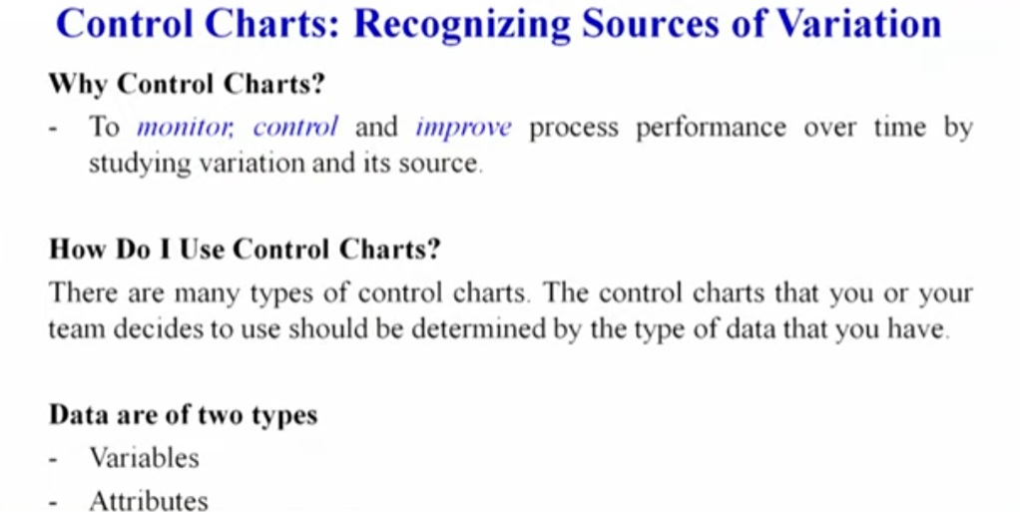

Slide 23
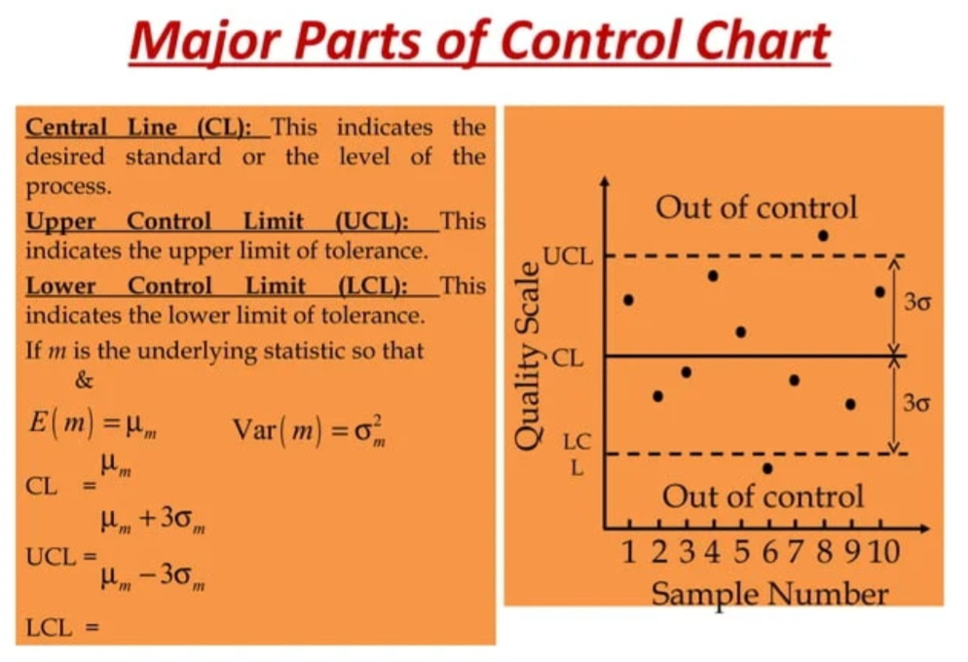

Slide 24
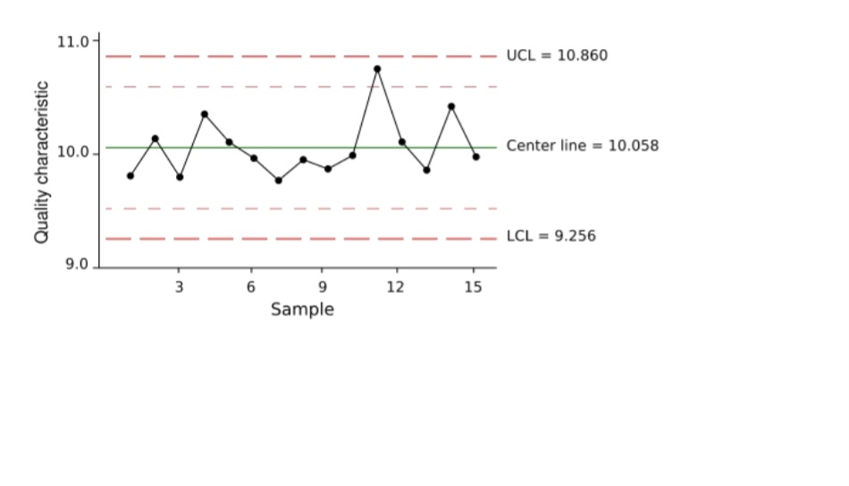

Slide 25
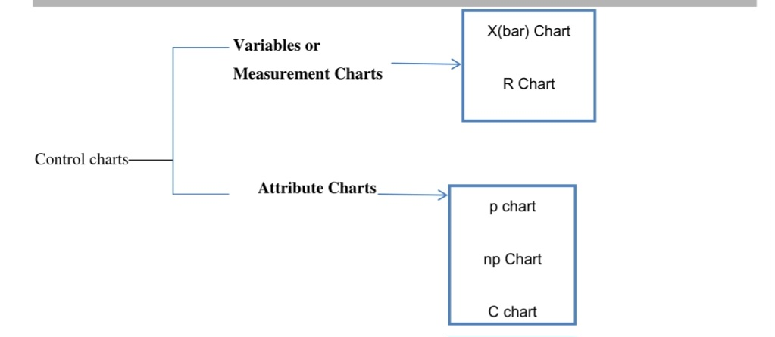
Types of control charts

Slide 26
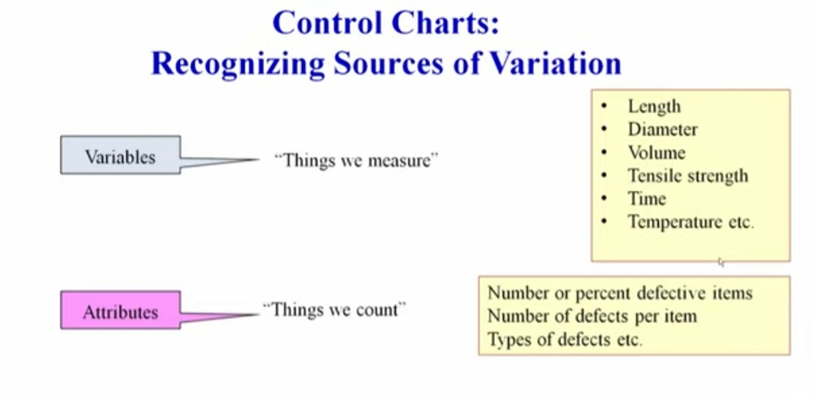

Slide 27
A control chart for variables
This chart is used to monitor characteristics that can be measured and have a continuum of values, such as height, weight, or volume. A soft drink bottling operation is an example of a variable measure, since the amount of liquid in the bottles is measured and can take on a number of different values.
Other examples are the weight of a bag of sugar, the temperature of a baking oven, or the diameter of plastic tubing.

Slide 28
A control chart for attributes
This chart is used to monitor characteristics that have discrete values and can be counted. Often they can be evaluated with a simple yes or no decision. Examples include color, taste, or smell. The monitoring of attributes usually takes less time than that of variables because a variable needs to be measured
An attribute requires only a single decision, such as yes or no, good or bad, acceptable or unacceptable (e.g., the apple is good or rotten, the meat is good or stale, the shoes have a defect or do not have a defect, the lightbulb works or it does not work) or counting the number of defects (e.g., the number of broken cookies in the box, the number of dents in the car

Slide 29
Mean (x-Bar) Charts
A mean control chart is often referred to as an x-bar chart. It is used to monitor changes in the mean of a process.
To construct a mean chart
we first need to construct the center line of the chart. To do this we take multiple samples and compute their means.
Usually these samples are small, with about four or five observations.
sample has its own mean. The center line of the chart is then computed as the mean of all sample means
1.It shows changes in process average and is affected by changes in process variability.
2. It is a chart for the measure of central tendency.
3. It shows erratic or cyclic shifts in the process.
4. It detects steady progress changes, like tool wear.
5. It is the most commonly used variables chart.

Slide 30
6. When used along with R chart:
It tells when to leave the process alone and when to chase and go for the causes leading to variation;
b. It secures information in establishing or modifying processes, specifications or inspection procedures; c. It controls the quality of incoming material.
7. X-Bar and R charts when used together form a powerful instrument for diagnosing quality problems.

Slide 31
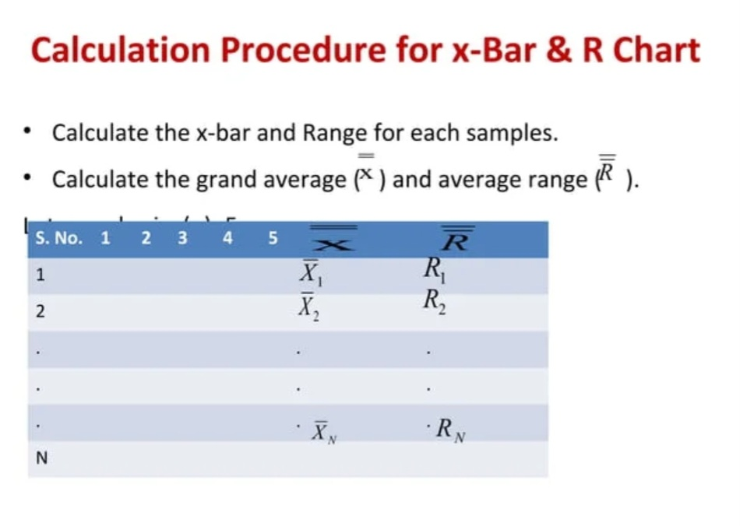

Slide 32
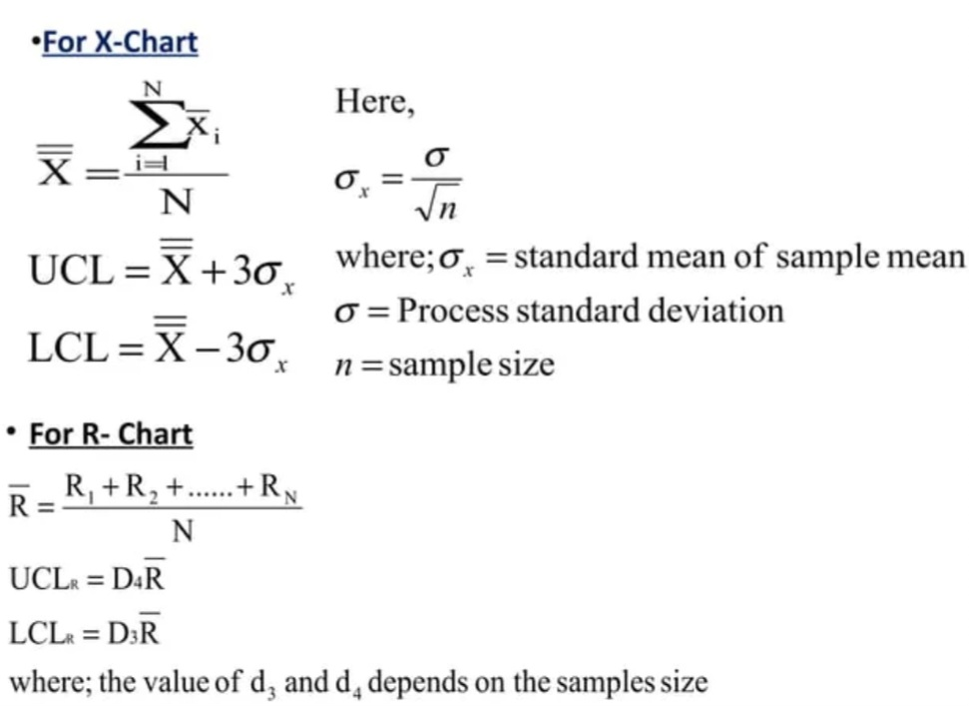

Slide 33
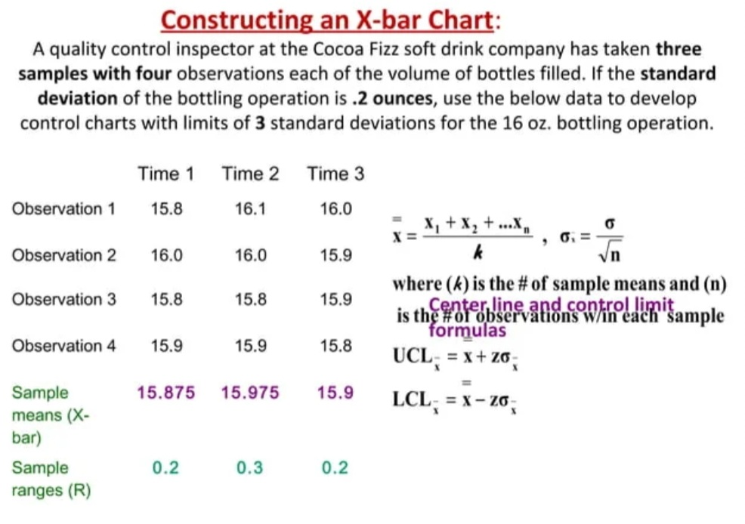

Slide 34
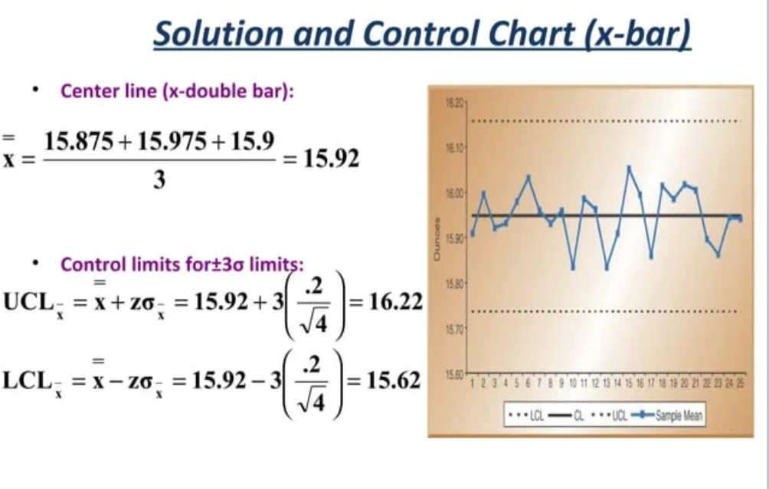

Slide 35
Range (R) charts
These are another type of control chart for variables. Whereas x-bar charts measure shift in the central tendency of the process, range charts monitor the dispersion or variability of the process.
The method for developing and using R-charts are the same as that for x-bar charts.
The center line of the control chart is the average range, and the upper and lower control limits are computed.
The R chart is used to monitor process variability when sample sizes are small.
This chart is called the R chart because the statistic being plotted is the sample range.
It controls general variability of the process and is affected by changes in process variability.
2. It is a chart for measure of spread. It is generally used along with X-bar chart.

Slide 36
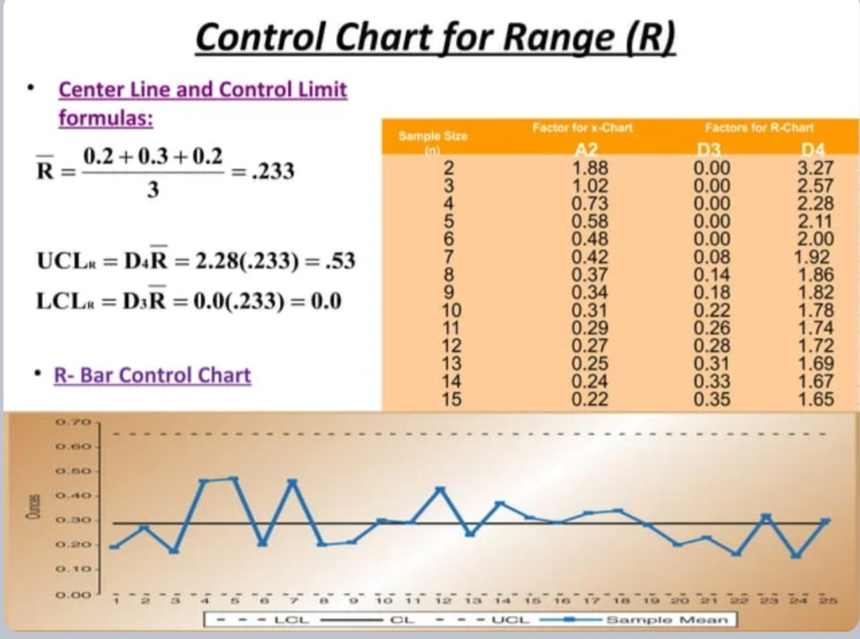

Slide 37
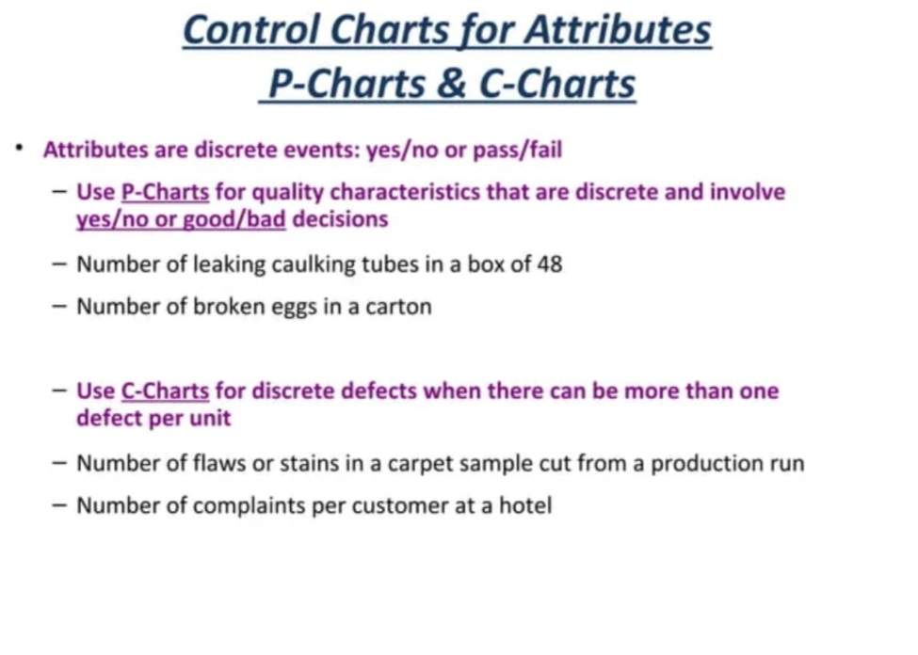

Slide 38
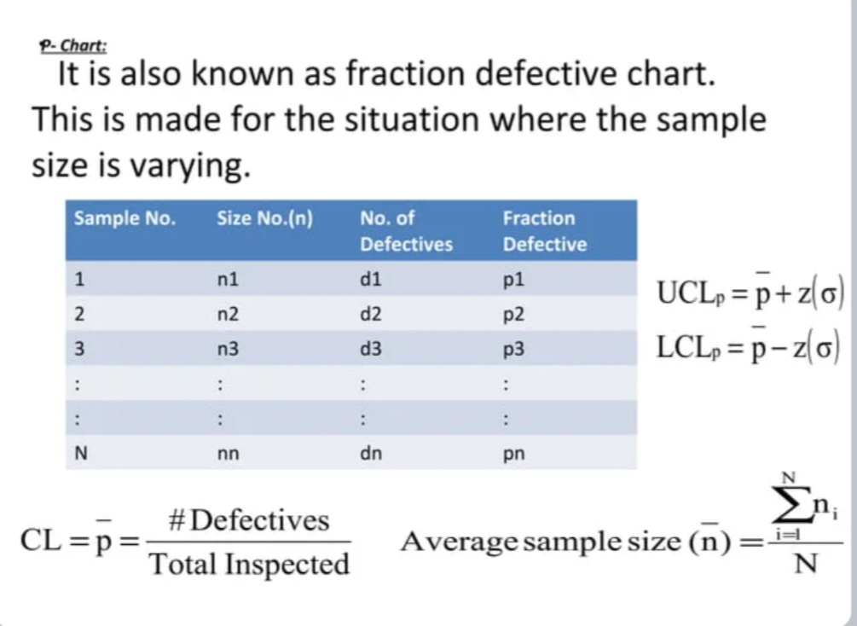

Slide 39
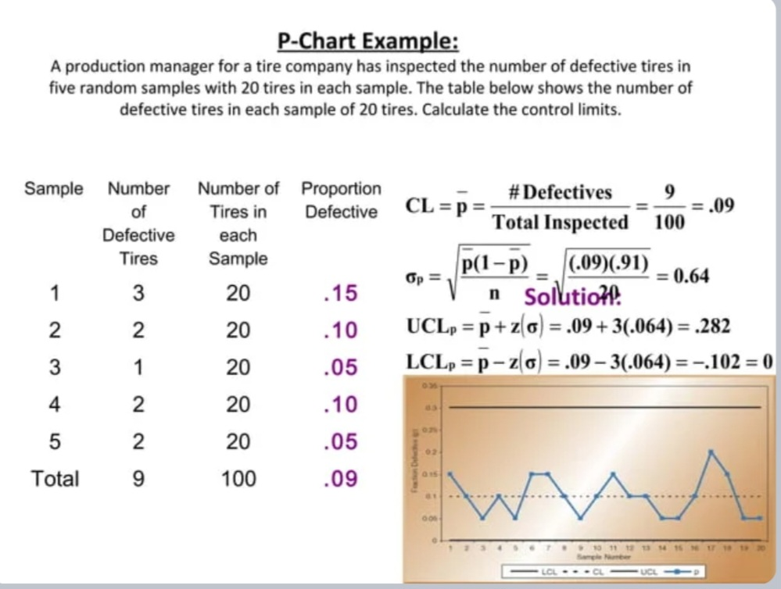

Slide 40
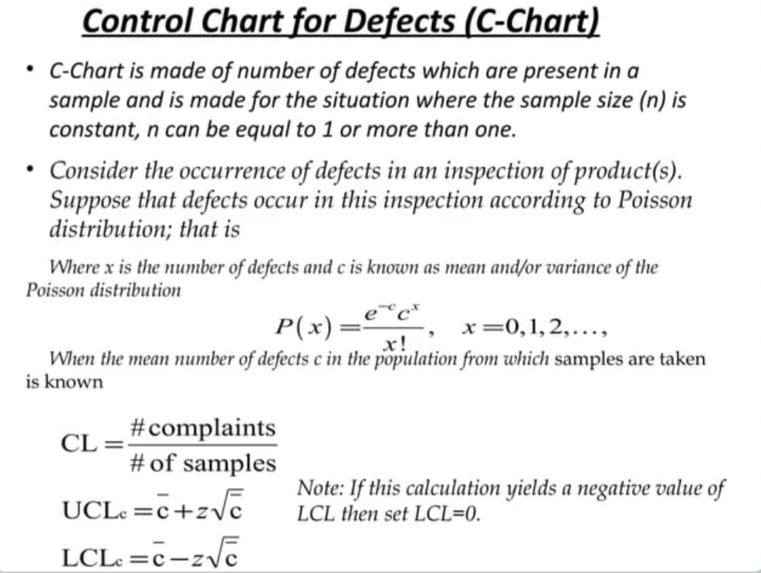

Slide 41
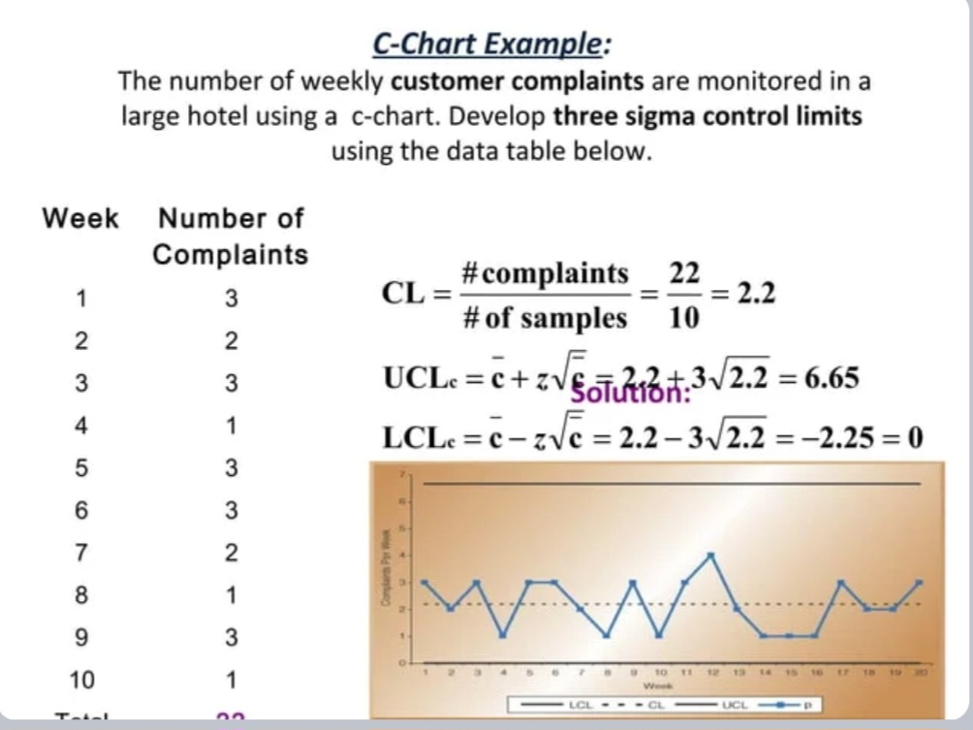

Slide 42
np Chart
The np-chart is an adaptation of the basic p-chart. The purpose of this chart is to provide a better understanding to the operator who may understand actual number of defective items easily rather than the proportion defective.
However, there is one drawback of the np-chart: It is used only for equal sample size because the number of defectives cannot be compared for variable sample size.
For example, suppose we get one defective item in a sample of size 10 and one defective item in a sample of size 100. In both samples, we get one defective item, but the first sample shows a much higher rate of problems, that is 10%, in comparison to the second.

Slide 43
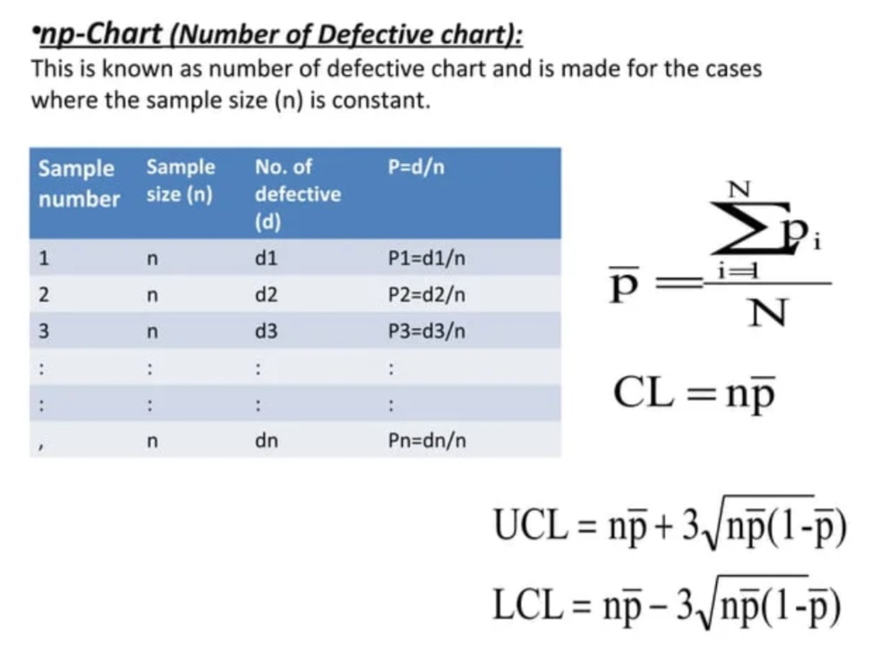

Slide 44
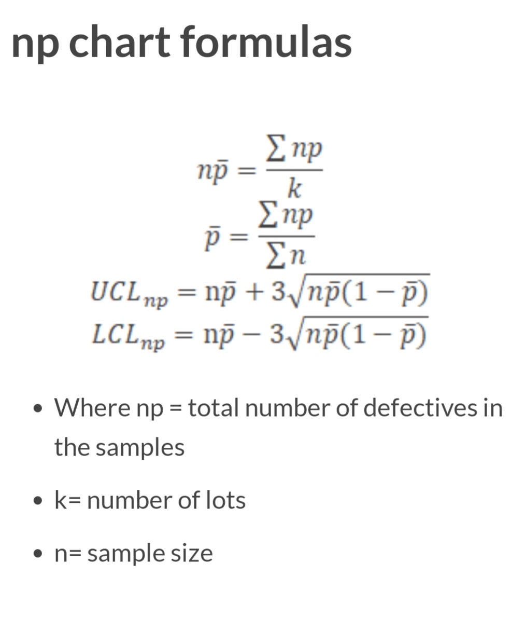

Slide 45
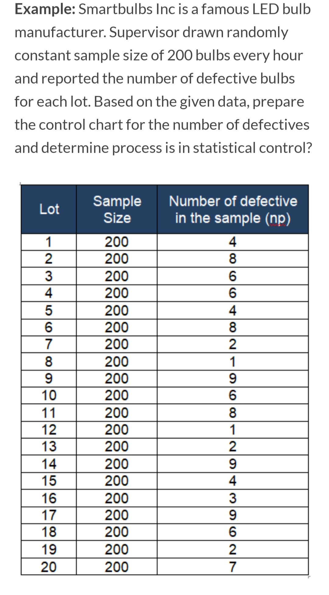

Slide 46
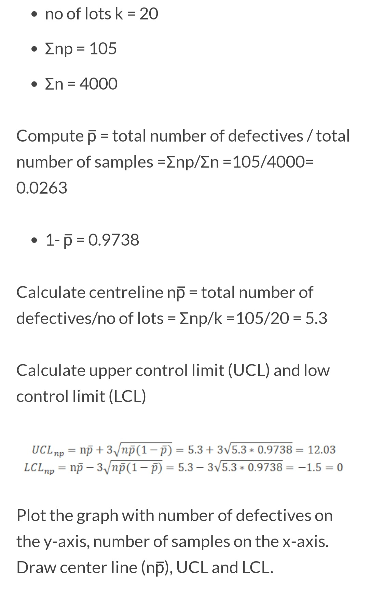

Slide 47
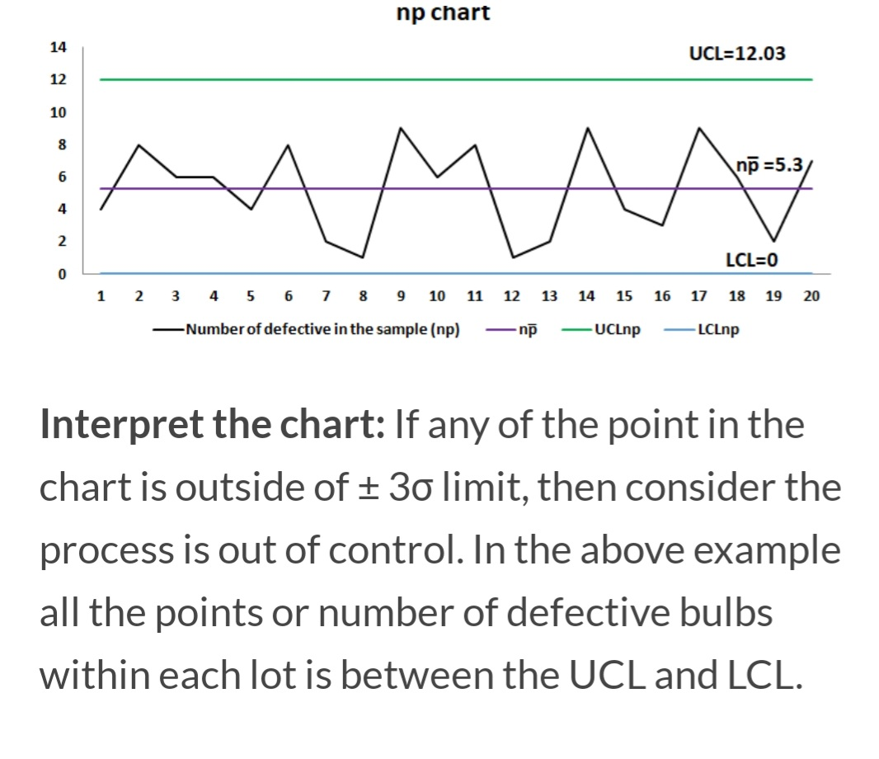

Slide 48
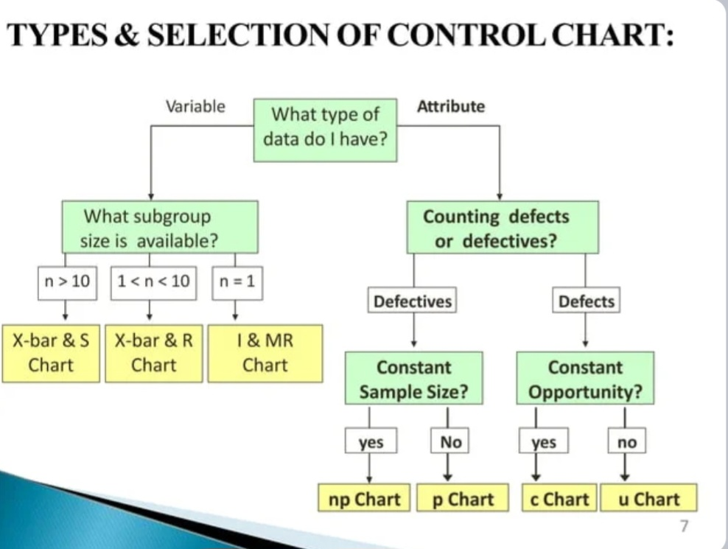

Slide 49
Advantages Of SQC over 100 percent inspection:
Reduction in cost: Since only a fractional output is inspected, hence cost of inspection is greatly reduced.
Greater efficiency: It requires lesser time and boredom as compared to the 100 percent inspection and hence the efficiency increases.
Easy to apply: Once the S.Q.C plan is established, it is easy to apply even by man who does not have extensive specialized training.
Accurate prediction: Specifications can easily be predicted for the future, which is not possible even with 100 percent inspection.
Can be used where inspection is needs destruction of items: In cases where destruction of product is necessary for inspecting it, 100 percent inspection is not possible (which will spoil all the products), sampling inspection is resorted to.
Early detection of faults: The moment a sample point falls outside the control limits, it is taken as a danger signal and necessary corrective measures are taken. Whereas in 100 percent inspection, unwanted variations in quality may be detected after large number of defective items have already been produced. Thus by using the control charts, we can know from graphic picture that how the production is proceeding and where corrective action is required and where it is not required.

Slide 50
ACCEPTANCE SAMPLING
“Acceptance Sampling is concerned with the decision to accept a mass of manufactured items as conforming to standards of quality or to reject the mass as non-conforming to quality. The decision is reached through sampling.” - SIMPSON AND KAFKA
Acceptance sampling uses statistical sampling to determine whether to accept or reject a production lot of material.
It has been a common quality control technique used in industry and particularly the military for contracts and procurement.
It is usually done as products leave the factory, or in some cases even within the factory.
Most often a producer supplies a consumer a number of items and decision to accept or reject the lot is made by determining the number of defective items in a sample from the lot.
The lot is accepted if the number of defects falls below where the acceptance number or otherwise the lot is rejected

Slide 51
The purpose of Acceptance Sampling is, therefore a method used to make a decision as to whether to accept or to reject lots based on inspection of sample(s).
Acceptance Sampling is very widely used in practice due to the following merits:
Acceptance Sampling is much less expensive than 100 percent inspection.
2. It is general experience that 100 percent inspection removes only 82 to 95 percent of defective material. Very good 100 percent inspection may remove at the most 99 percent of the defectives, but still cannot reach the level of 100 percent. Due to the effect of inspection fatigue involved in 100 percent inspection, a good sampling plan may actually give better results than that achieved by 100 percent inspection.
3. Because of its economy, it is possible to carry out sample inspection at various stages.

Slide 52
Using sampling rather than 100% inspection of the lots brings some risks both to the consumer and to the producer, which are called the consumer's and the producer's risks, respectively. We encounter making decisions on sampling in our daily affairs.

Slide 53
Risks in Acceptance sampling
Producer’s risk-: Sometimes in spite of good quality, the sample taken may show defective units as such the lot will be rejected, such type of risk is known as producer’s risk.
2. Consumer’s Risk-: Sometimes the quality of the lot is not good but the sample results show good quality units as such the consumer has to accept a defective lot, such a risk is known as consumer’s risk.

Slide 54
Operating Characteristic Curve
The Operating Characteristic Curve (OC Curve) shows you the probability that you will accept lots with various levels of quality. It is the working plan of acceptance sampling.
AQL – Acceptance Quality Level - the maximum % defective that can be considered satisfactory as a process average for sampling inspection
RQL – Rejectable Quality Level- The RQL (Rejectable Quality Level) is the % defective that can be considered unsatisfactory and hence rejected. It is also known as the Lot Tolerance Percent Defective (LTPD).
LTPD – Lot Tolerance Percent Defective The LTPD of a sampling plan is a level of quality routinely rejected by the sampling plan. It is generally defined as that level of quality (percent defective, defects per hundred units, etc.) which the sampling plan will accept 10% of the time.

Slide 55
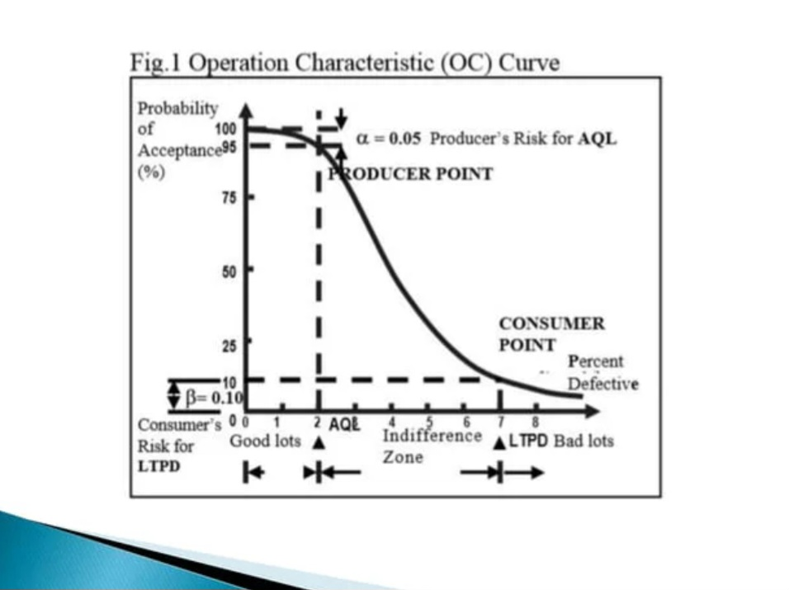

Slide 56
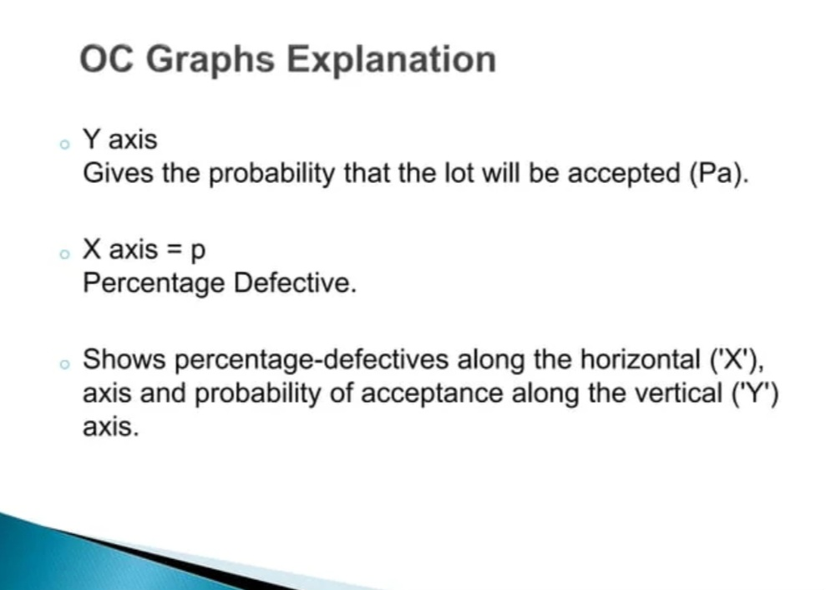

Slide 57
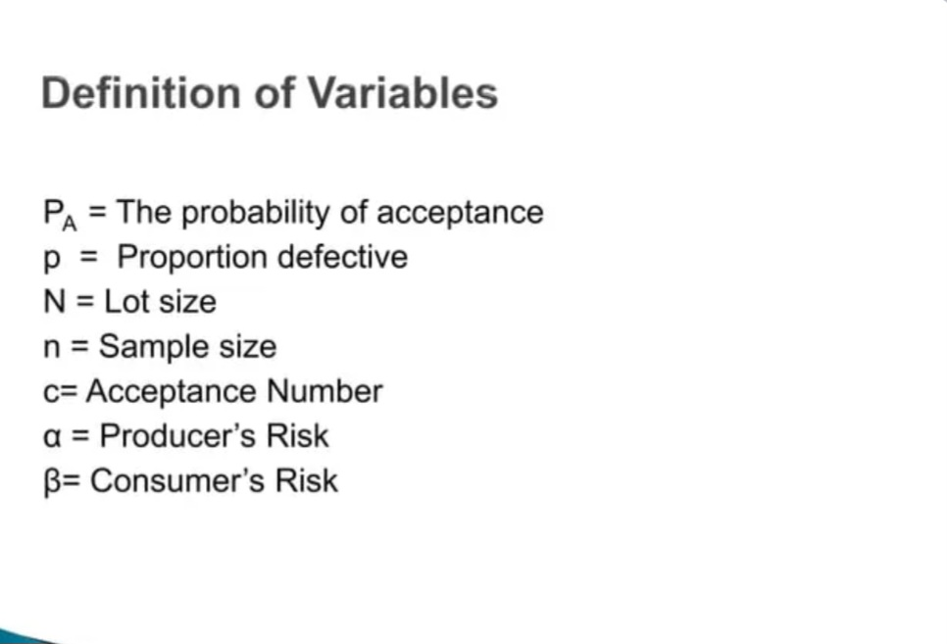

Slide 58
ACCEPTANCE SAMPLING PLANS
Single Sampling Plan In single sampling plan, the decision regarding the acceptance or rejection is made after drawing a sample from a bigger lot. Inspection is done and if the defectives exceed a certain number the lot is rejected. Otherwise, the lot is accepted when the number of defectives is less than the acceptance number.
Double Sampling Plan In this, a small sample is first drawn. If the number of defectives is less than or equal to the acceptance number (C1) the lot is accepted. If the number of defectives is more than another acceptance number (C2) which is higher than C1 then the lot is rejected. If in case, the number in the inspection lies between C2 and C1, then a second sample is drawn. The entire lot is accepted or rejected on the basis of outcome of second inspection.

Slide 59
Sequential Sampling Plan
Sequential sampling plan is used when three or more samples of stated size are permitted and when the decision on acceptance or rejection must be reached after a stated number of samples.
A first sample of n1 is drawn, the lot is accepted if there are no more than c1 defectives, the lot is rejected if there are more than r1 defectives.
Otherwise a second sample of n2 is drawn. The lot is accepted if there are no more than c2 defectives in the combined sample of n1 + n2.
The lot is rejected if there are more than r2 defectives in the combined sample of n1 + n2.

Slide 60


Questions for continuous internal evaluation
Example 1
The following data gives the readings for 8 samples of size 6 each in the production of a certain product. Find the control limits using mean chart.
Given for n = 6, A₂ = 0.483,
Example 2
The following data gives readings of 10 samples of size 6 each in the production of a certain product. Draw control chart for mean and range with its control limits.

Slide 61
Q.3 Explain two types of causes for variation in a manufacturing process
Q. 4 Explain different types of control charts?
Q. 5 What are the single and double sampling plans?
Q. 6 Explain acceptance sampling in detail.

Slide 62
Thank You

